Slide 1
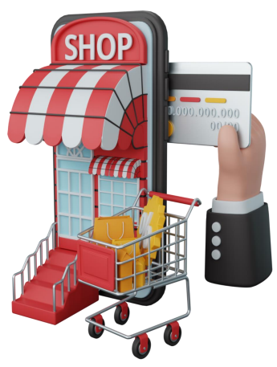
Sterling E Commerce Performance Analysis

Slide 2
Introduction
Sterling E-Commerce is a one-stop online shopping destination for a wide range of high-quality products whose mission is to provide their customers with the best shopping experience possible and focus on quality, affordability, and convenience of their clients.
From the data gather ( Oct 2021 – Sept 2022), we provided valuable Insights into customer’s Interactions with company’s products across the country using a meticulous data evaluation process, which involve data cleaning and visualization.

Slide 3
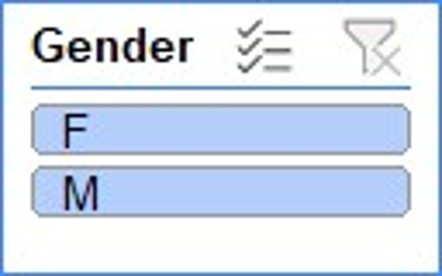
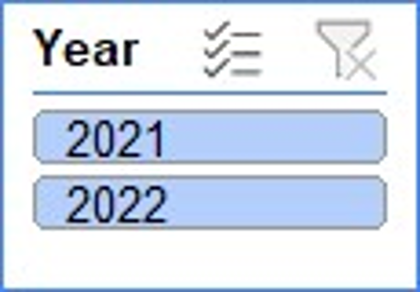
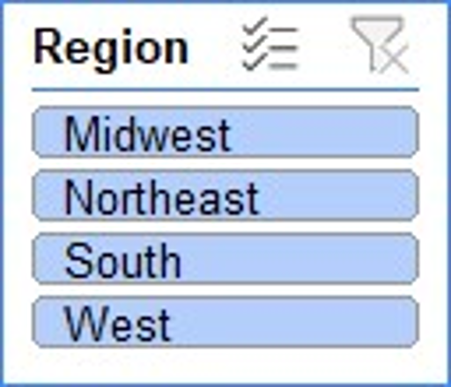
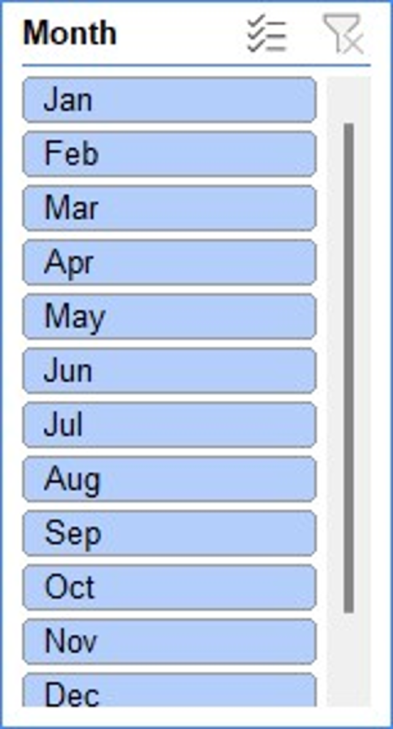
STERLING E-COMMERCE

Slide 4
Total Male
Total Female
STERLING E-COMMERCE

Slide 5
Revenue Trend For The Period In View
Total Number of Qty ordered 851,577
Total Revenue $ 2,310,611,039
Dec 2021 stood out to have the highest Revenue & Qty of Order
Notably, Feb 2022 recorded the Lowest Revenue
If The current business trend of E-commerce persists , the average sales projection for the next 3 months in 2022 ranges between $ 17,826,937 and $17,892,050,36
However , it is important to recognize that projection might undergo adjustments due to factors beyond our control
Of all the forecast approach been used the Simple linear Regression has the highest accuracy of 99.70%

Slide 6
Yearly Performance
In 2021, the revenue amounted to $ 73,583,702 and the Qty ordered was 249,620
In 2022, a revenue of $157,477,335 has been recorded and the Qty ordered is 601,957
The quarterly performance could not been look into because we have just 3months record from 2021, hence can’t compare with 2022

Slide 7
Category Performance
Mobile and Tablets is the most bought products among all the 15 categories of product , with 718,356 qty order and revenue of $128,600,063
Appliances follows closely with 769,889 qty ordered and $ 29,805,770 generated
Books recorded the lowest revenue of $ 32,247 but qty ordered was 849,446

Slide 8
Customer’s Behavior
Based on our analysis , we identified 63,646 unique customers. Among these are 51% male and 49% female.
In accessing the impact of each customers by revenue generated from their order, the highest revenue was made from Dobbins Everette followed by Cobb Joleen but in terms of qty ordered Gonzalex Joel placed the highest orders

Slide 9
Region
We observed that across the country , South generated the highest revenue , follow by Midwest . And in terms of categories, Mobiles and Tablets were most purchased
The revenue generated by customers in South and Midwest are 38.80% and 27.23% respectively, hence, amounting to 66.03% . indicating their substantial contribution to our financial performance compared to other regions.

Slide 10
Mode of Payment
The cod payment method stands out as the most favored option, representing the highest transaction method with 101,750 instances , followed by easypay with 68,915 instances

Slide 11
Recommendation
Capitalize on the success observed in Dec, our highest sales month in 2021,. Devote resources and marketing efforts to identify what factors contributed to this success and replicate them in other months
Products should be sold more to the South and Midwest of the country
More Incentives should be created to improve more sales generally across the country
The quantity in stock of products with low sales performance should be reduced to provide capital for hot selling products & enable cash flow for business.
Also, the top performing categories as visualized should be stocked more since they were mostly purchased.
For Payment method, other methods too should be user friendly

